Slide 1




.net aspire
by Sinan Nar

Slide 2
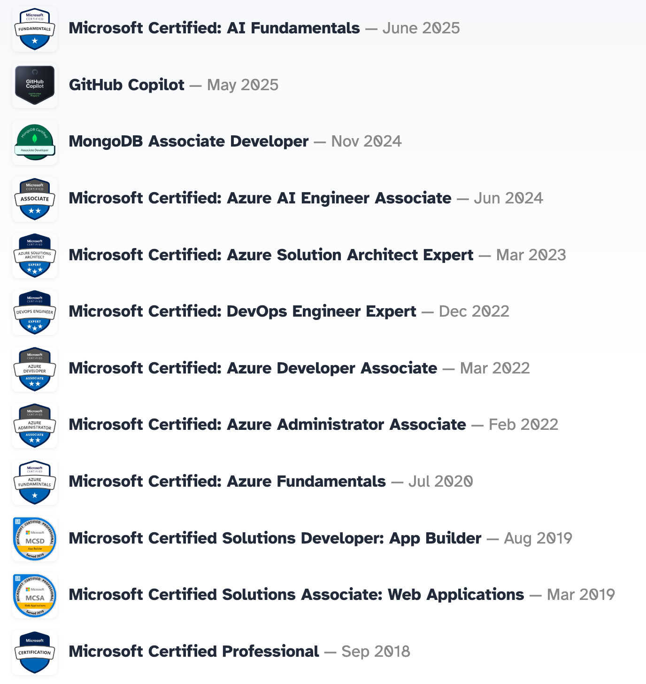

who am I
consultant
have 8+ yrs exp
have 3 rabbits

Slide 3

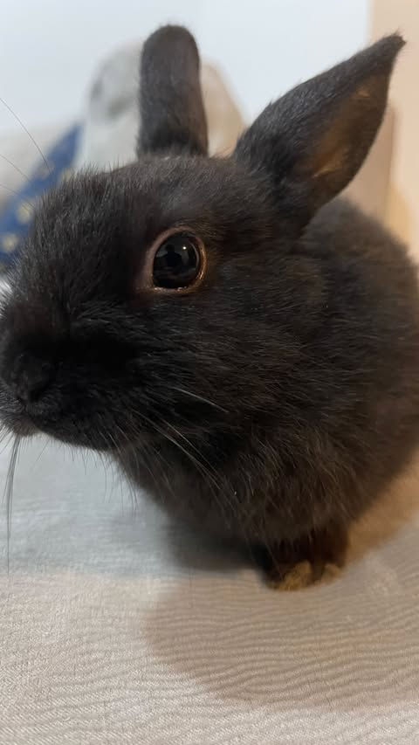

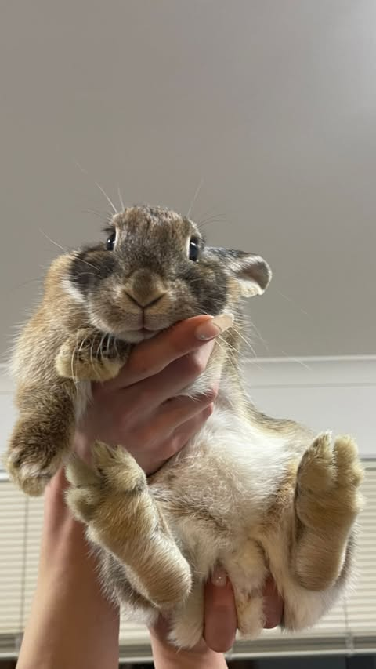

Slide 4
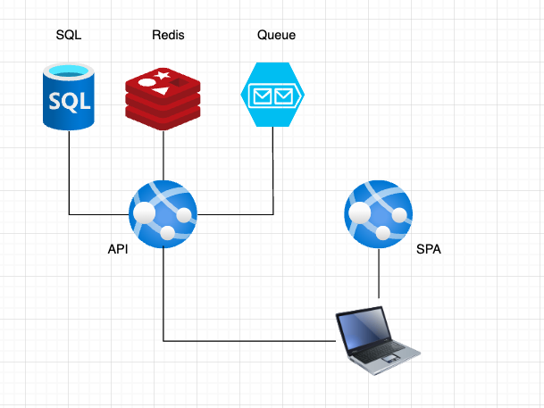
agenda
Notes:
We have dotnet API and angular FE
API is using SQL database,

Slide 5
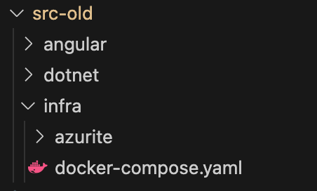
before aspire(folders)

Slide 6
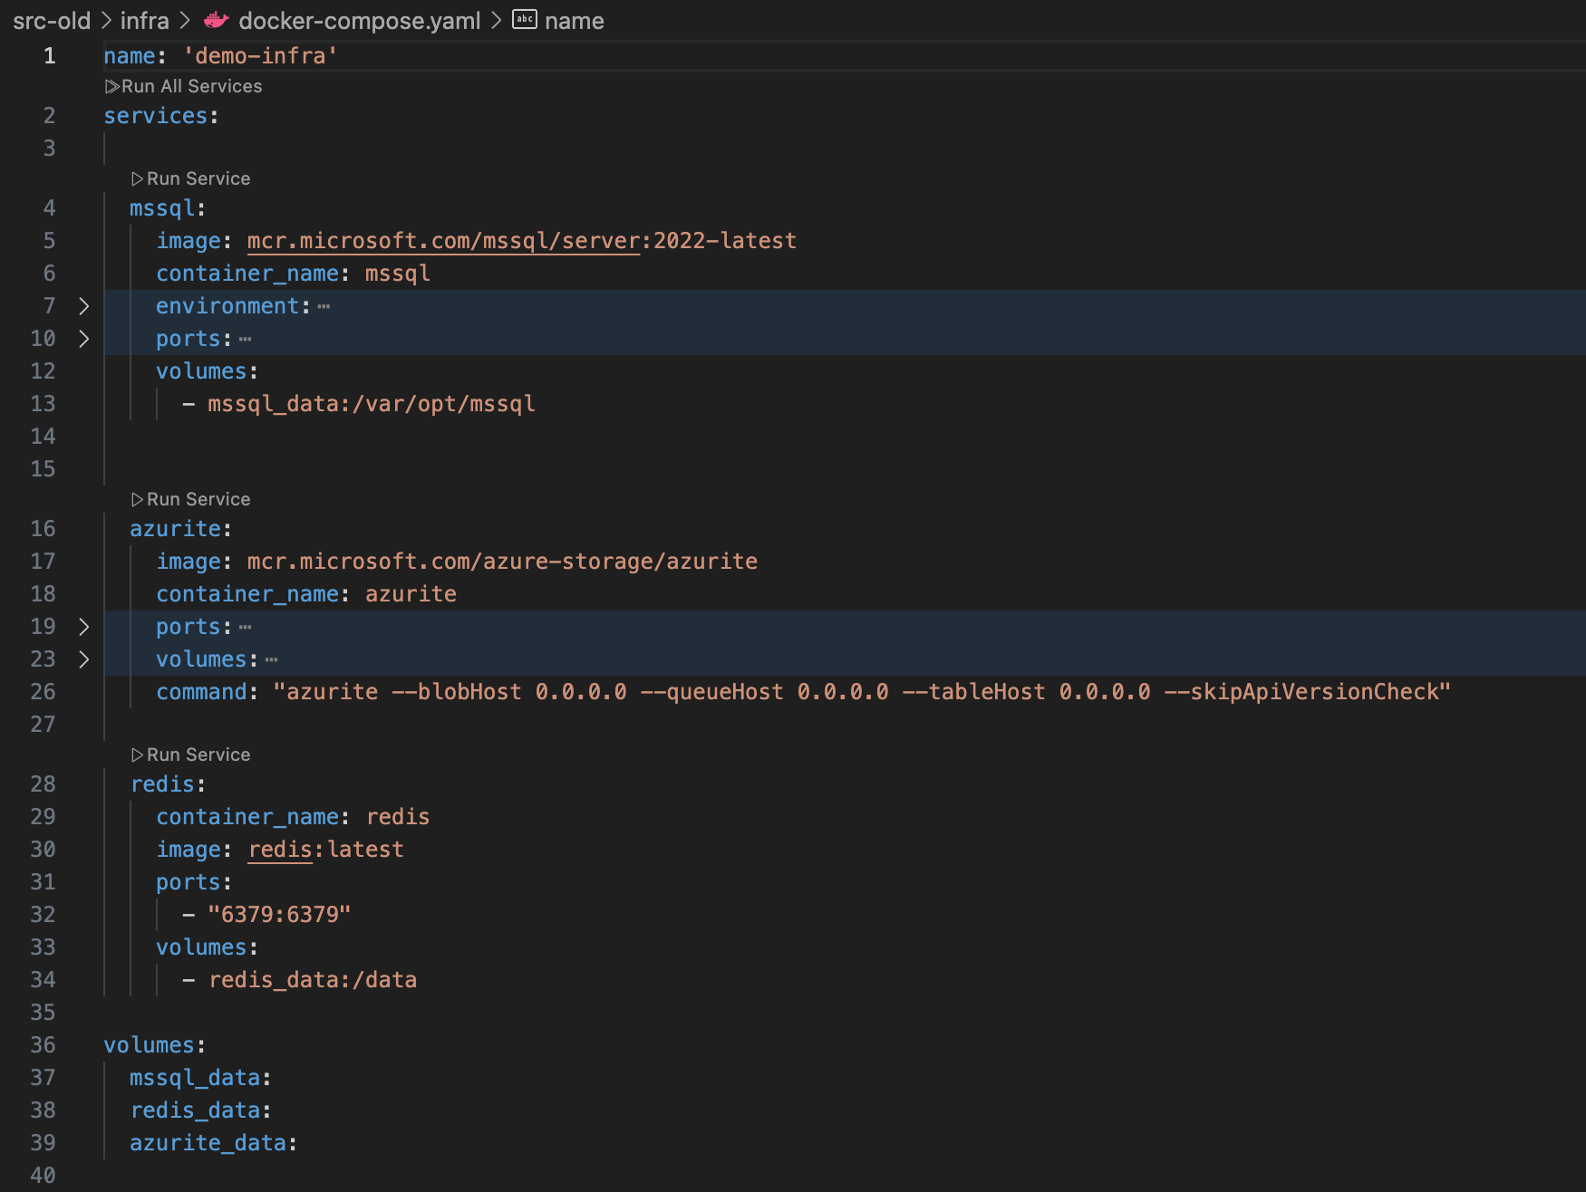
before aspire(w docker)

Slide 7
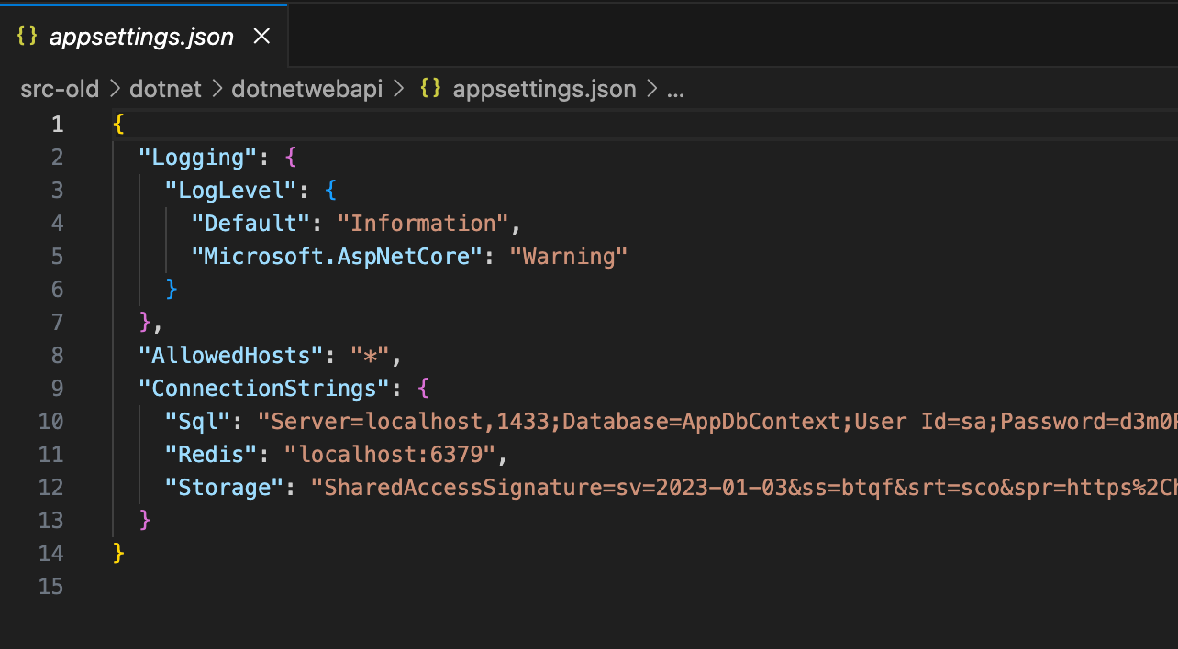
before aspire(conn str)

Slide 8
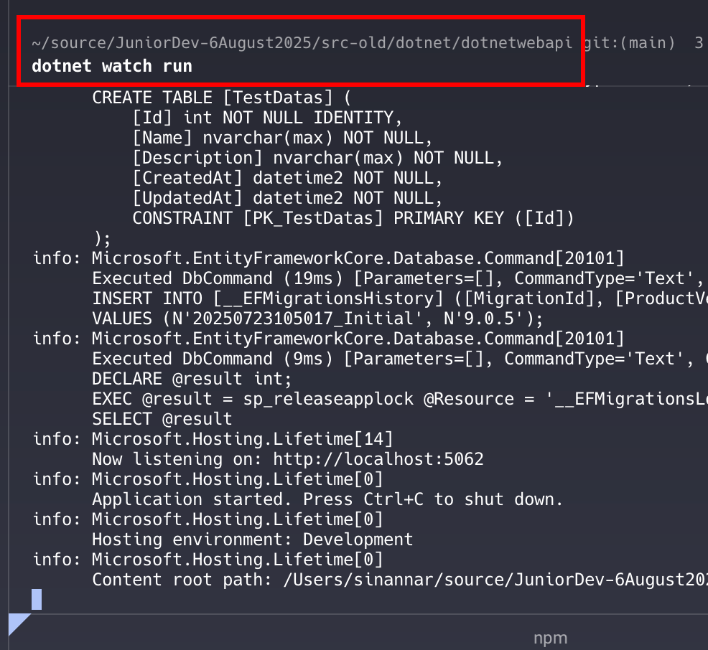
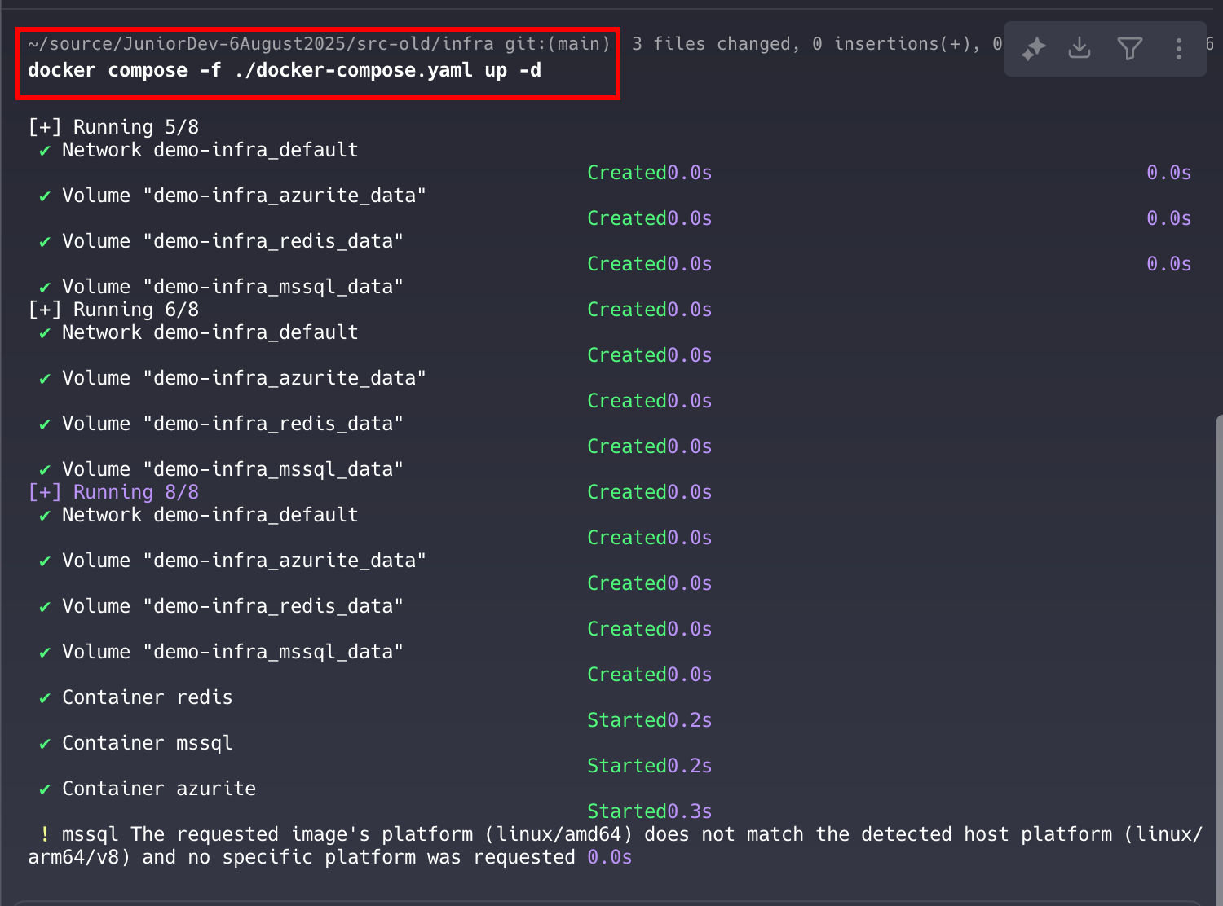
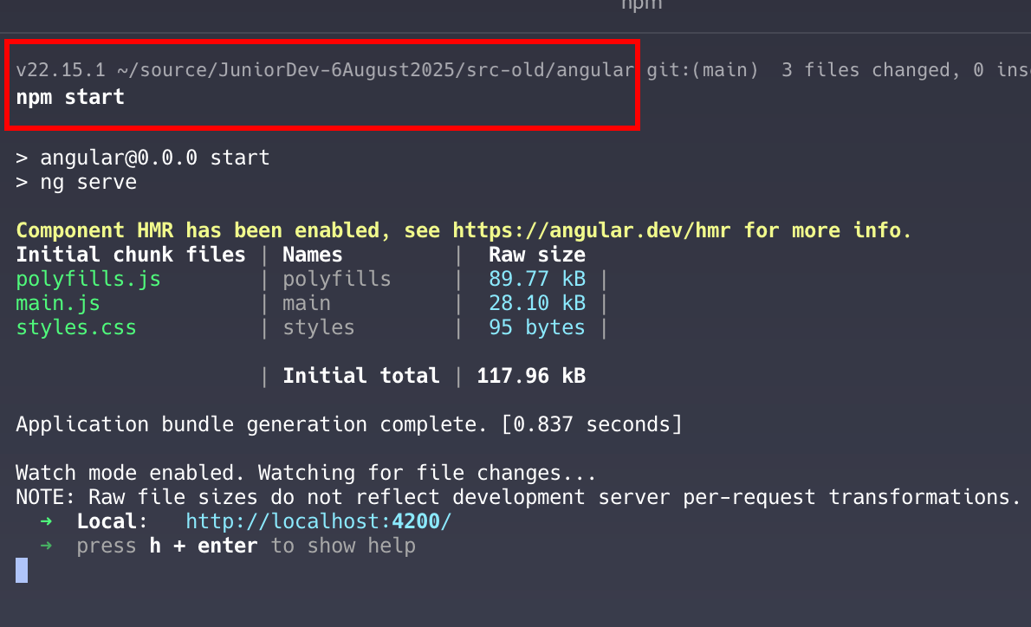
before aspire(running)
2
1
3

Slide 9
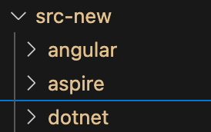
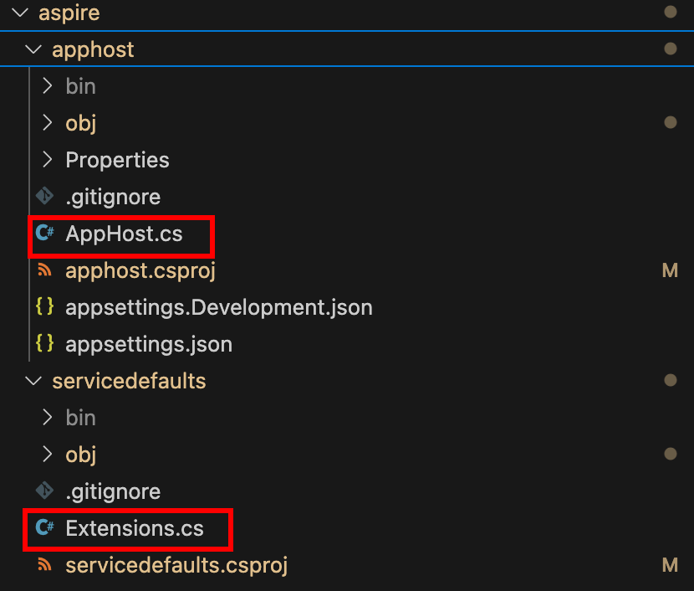
after aspire(folders)

Slide 10
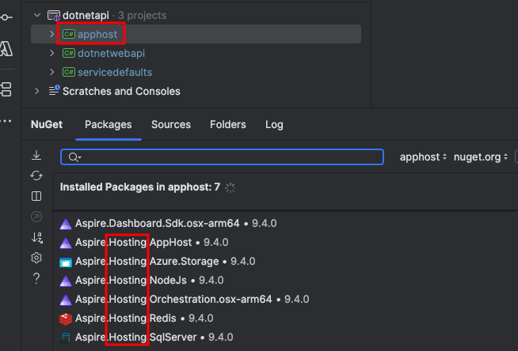
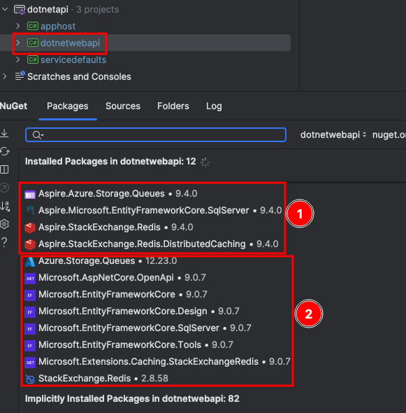
after aspire(nuget)

Slide 11
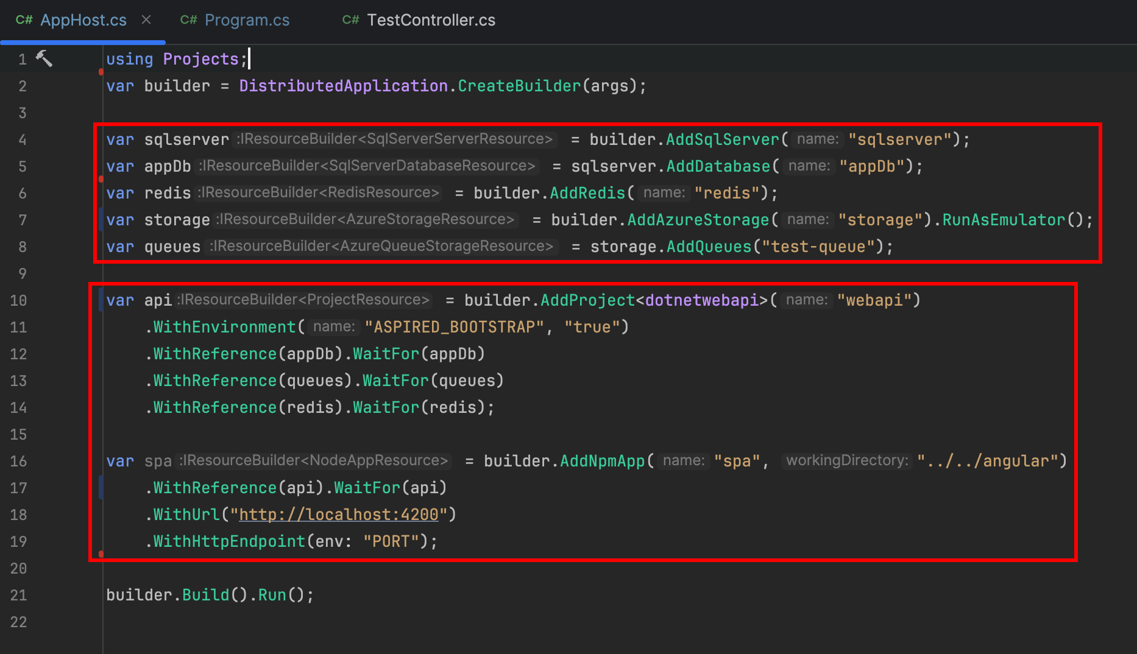
after aspire(apphost)

Slide 12
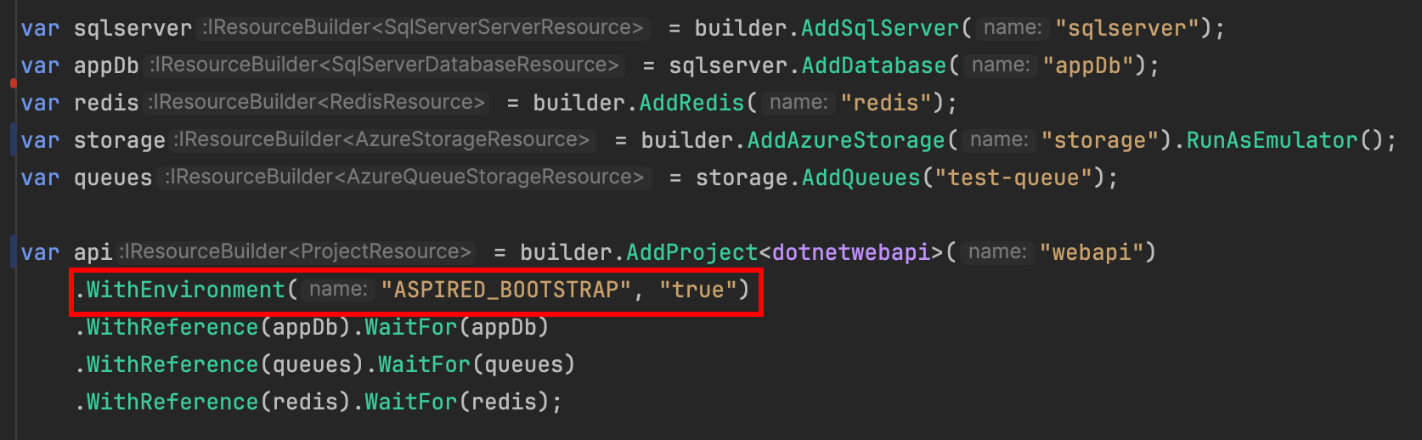
after aspire(conn str)

Slide 13
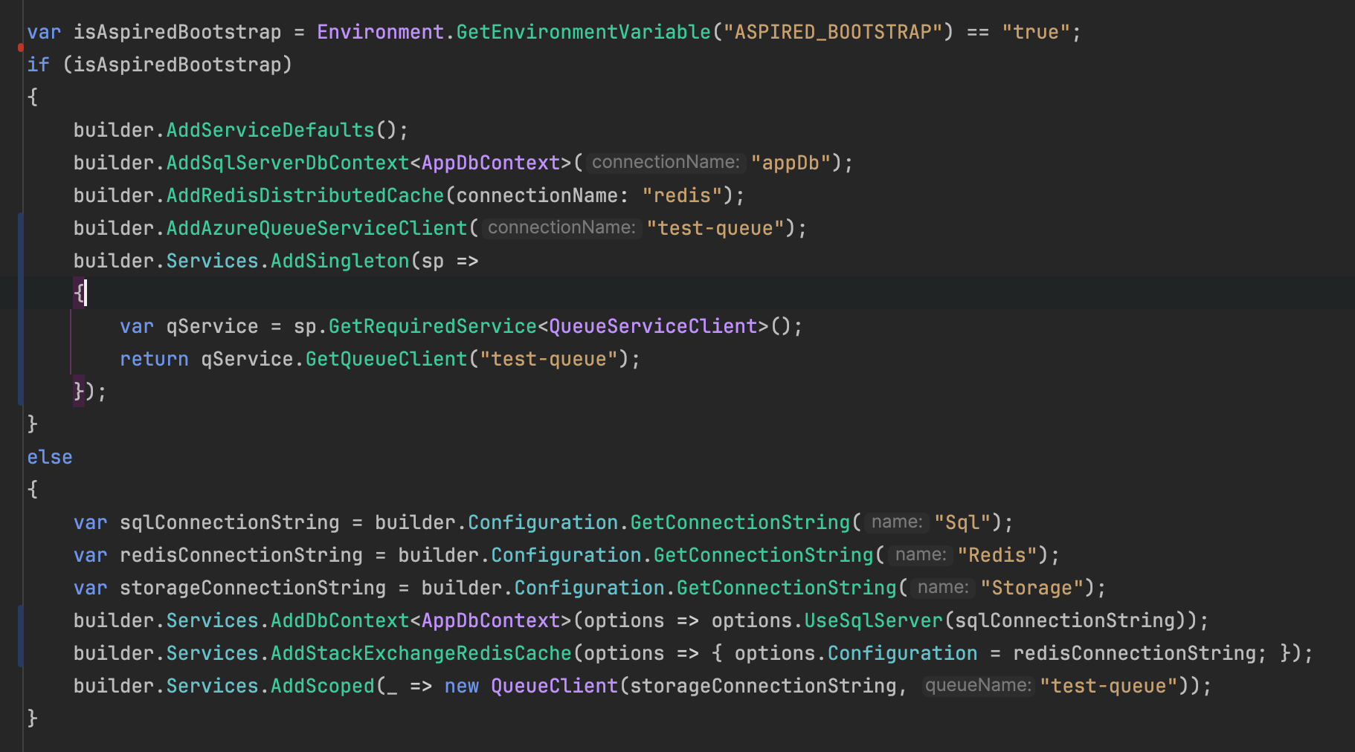
after aspire(conn str cont.)

Slide 14
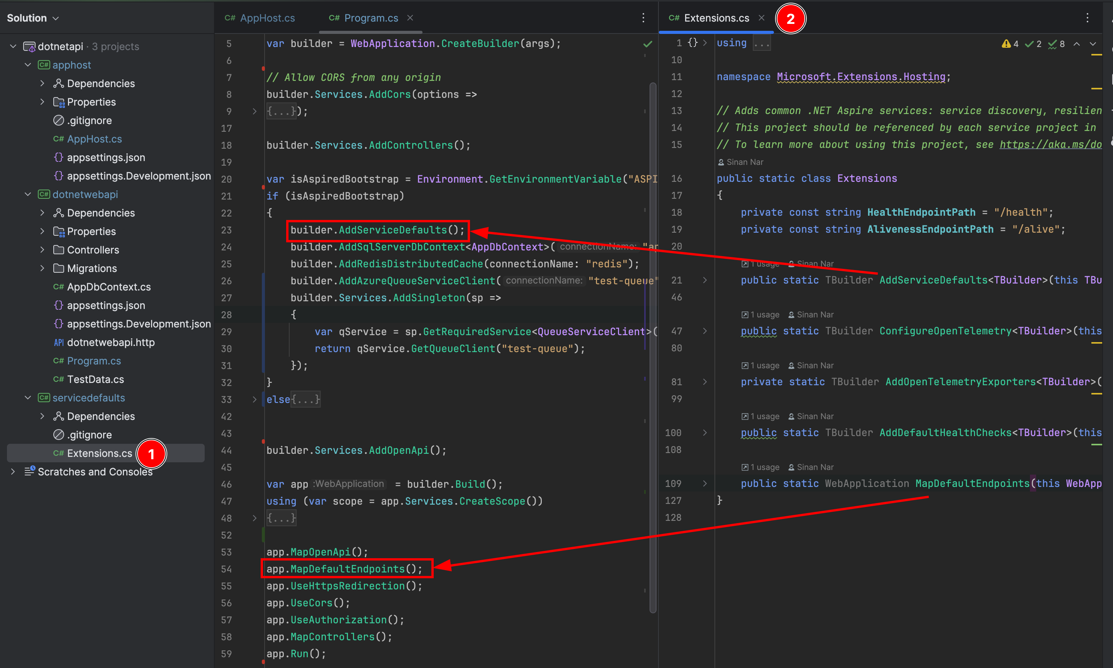
after aspire(defaults)

Slide 15
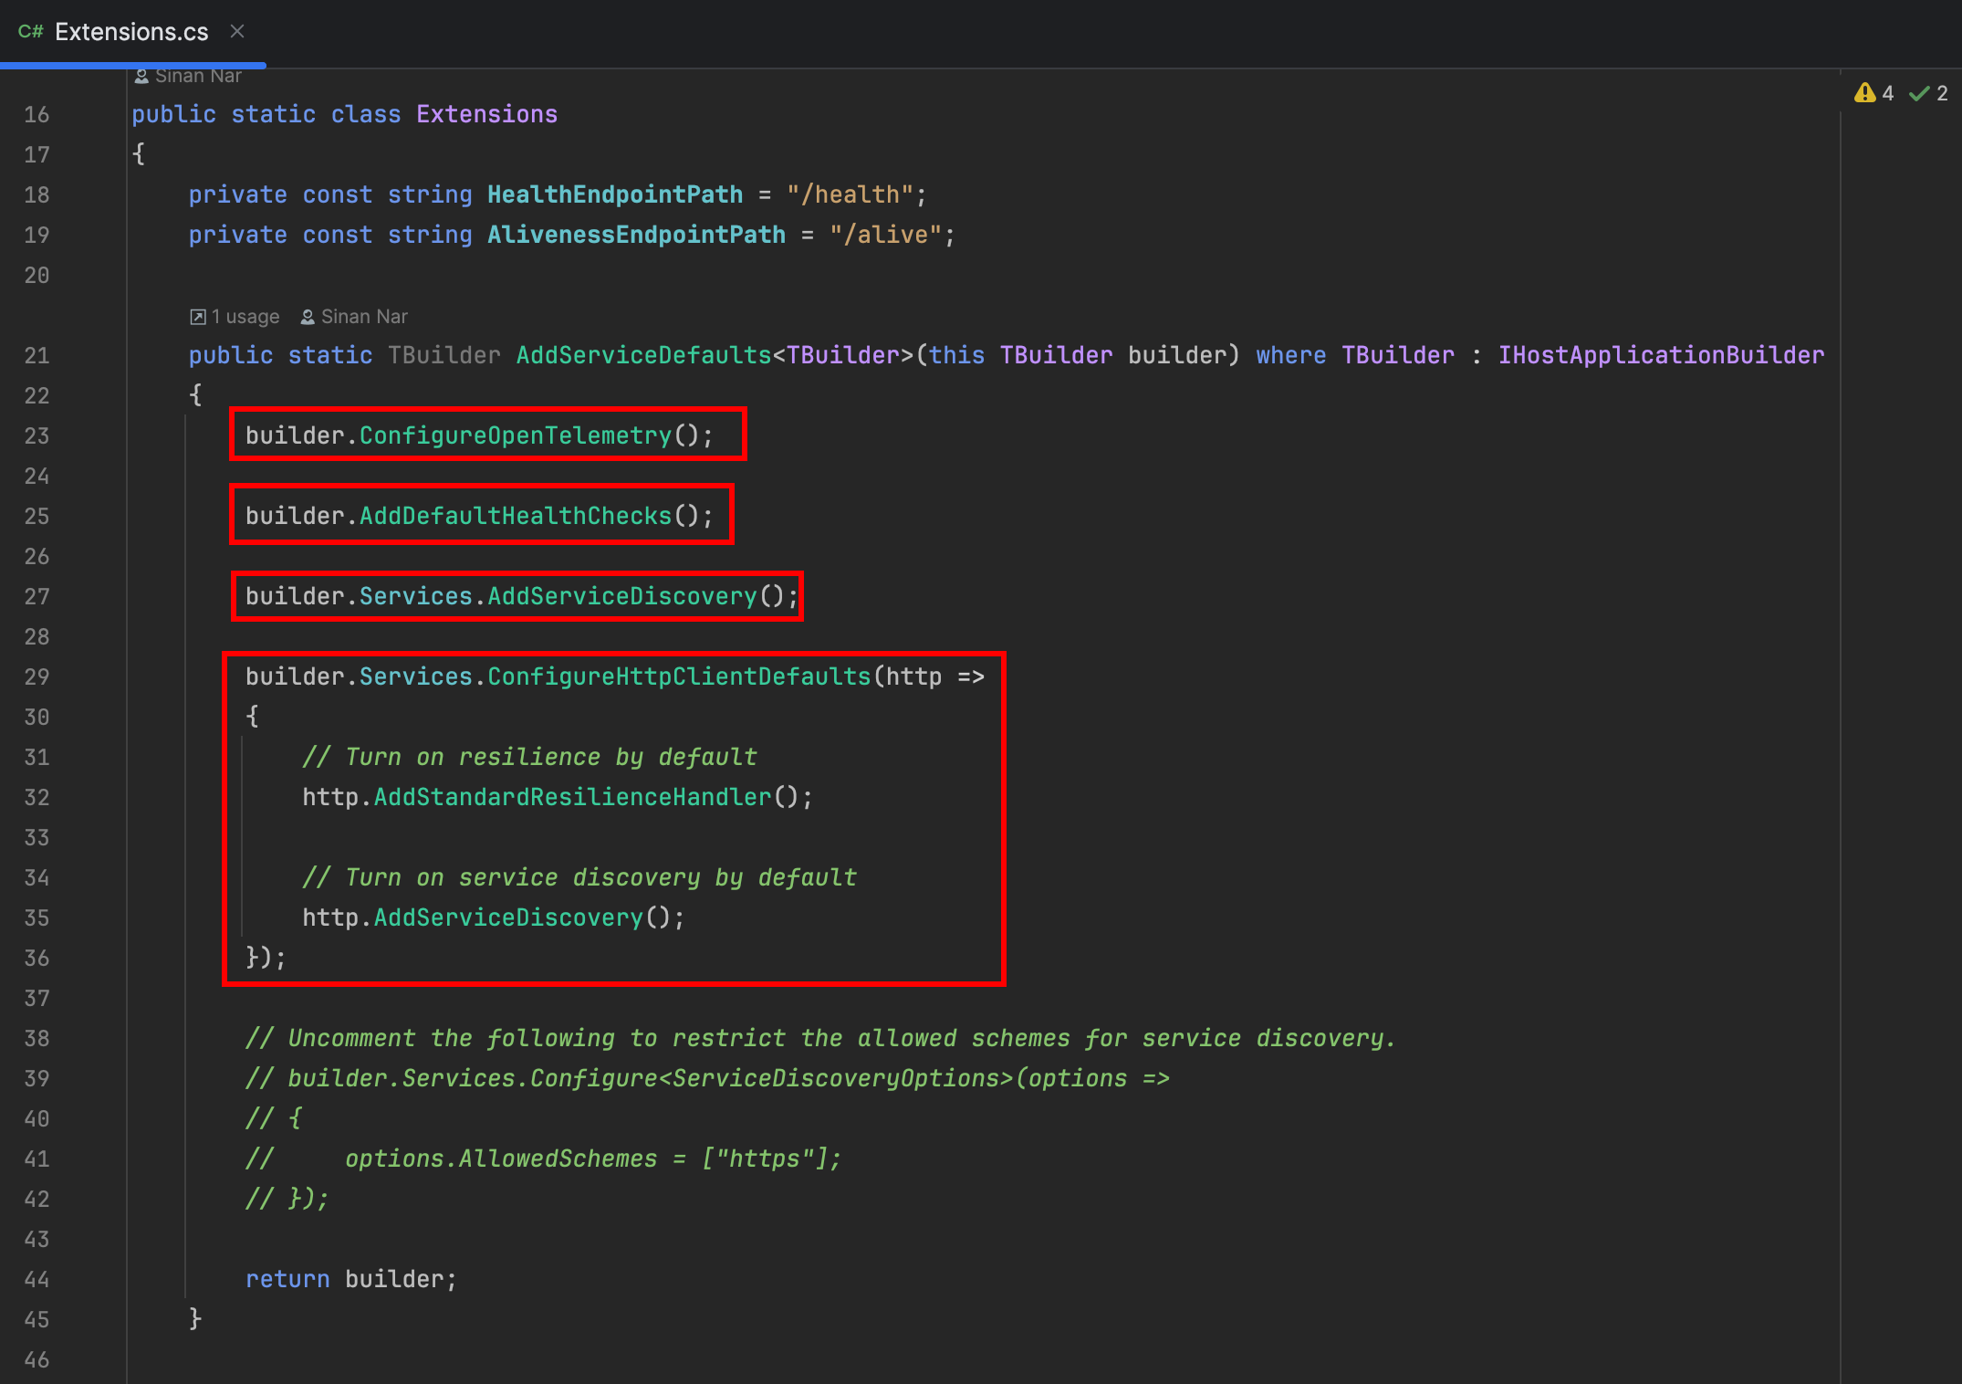
after aspire(defaults cont.)

Slide 16
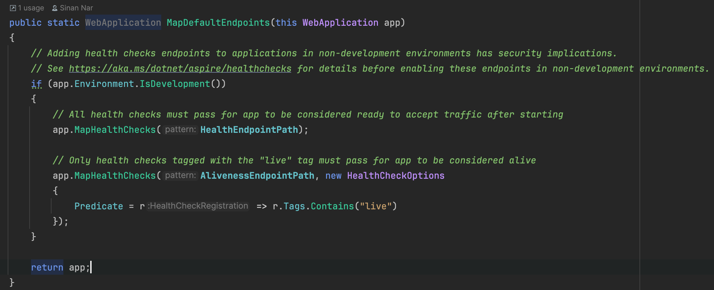
after aspire(defaults cont.)

Slide 17
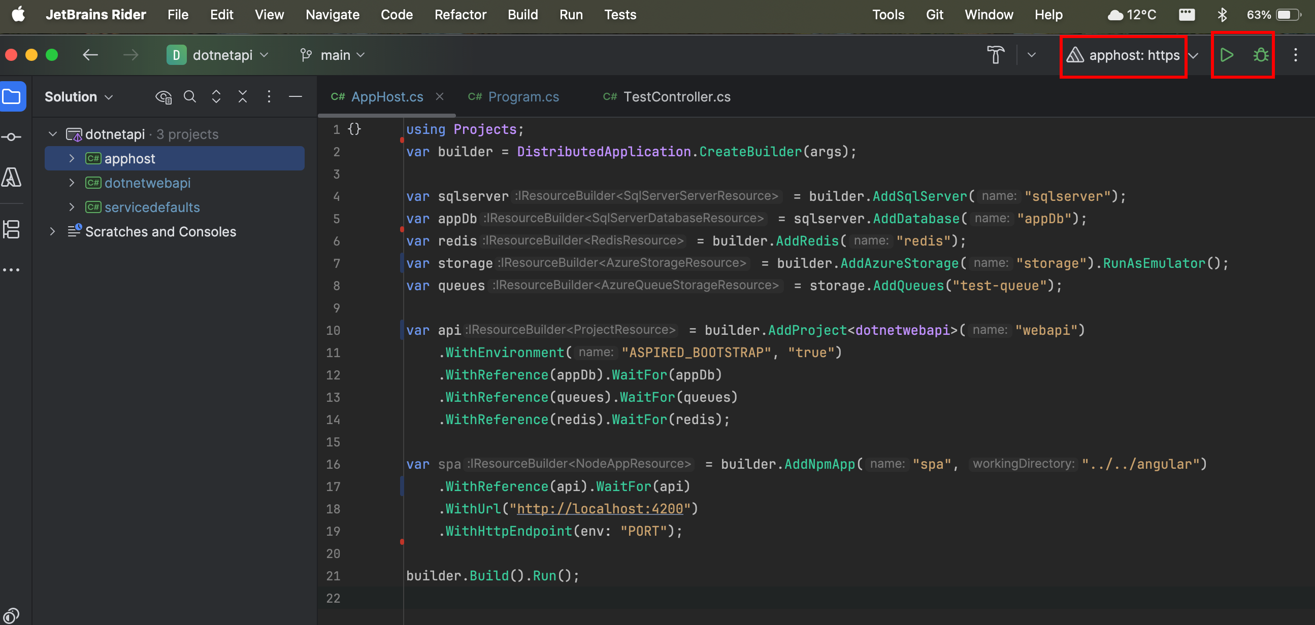
after aspire(running)

Slide 18
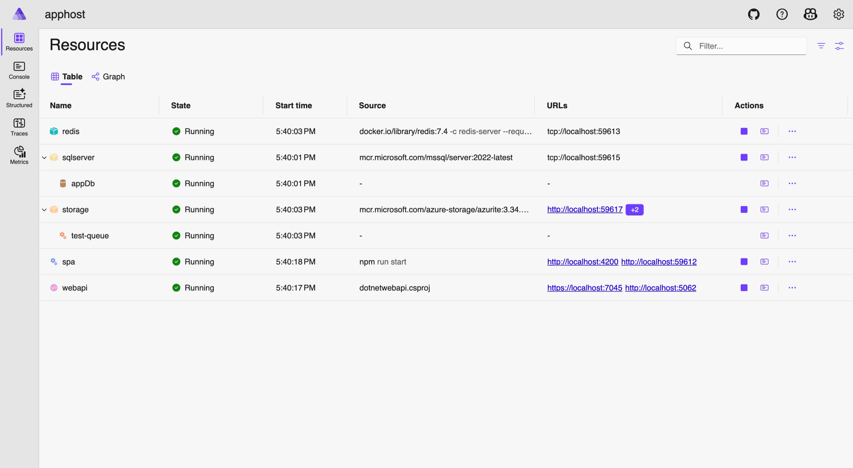
aspire dashboard

Slide 19
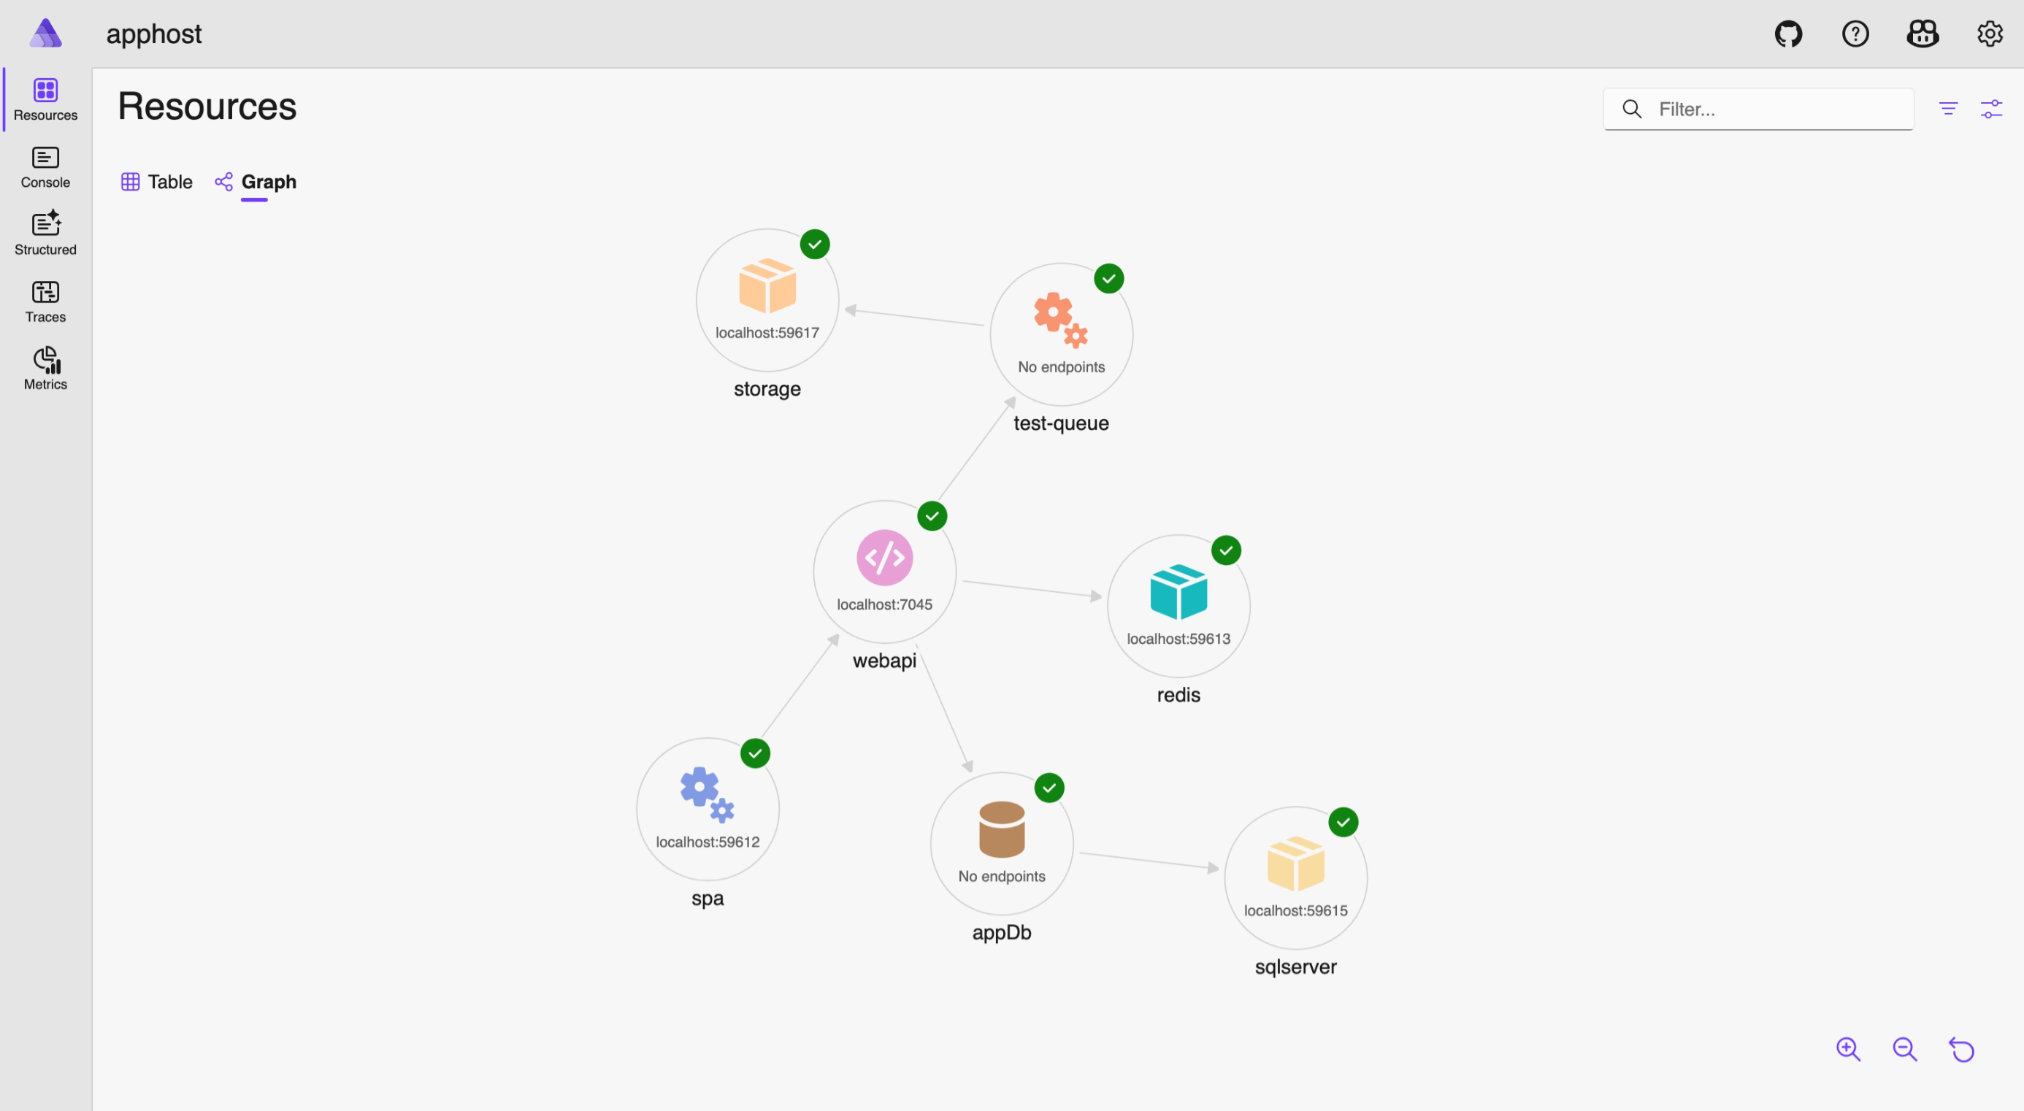
aspire dashboard (cont.)

Slide 20
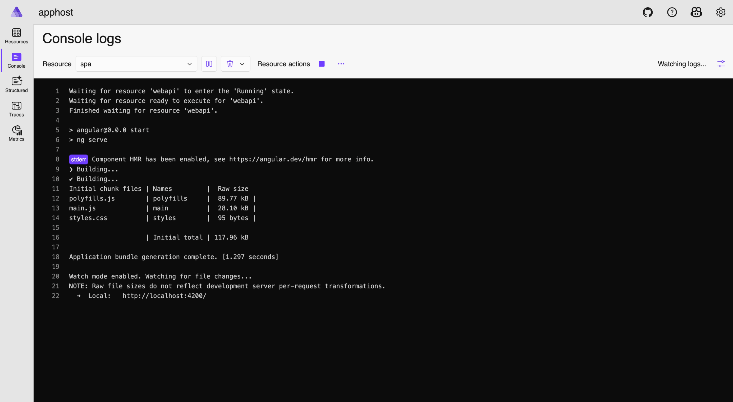
aspire dashboard (cont.)

Slide 21
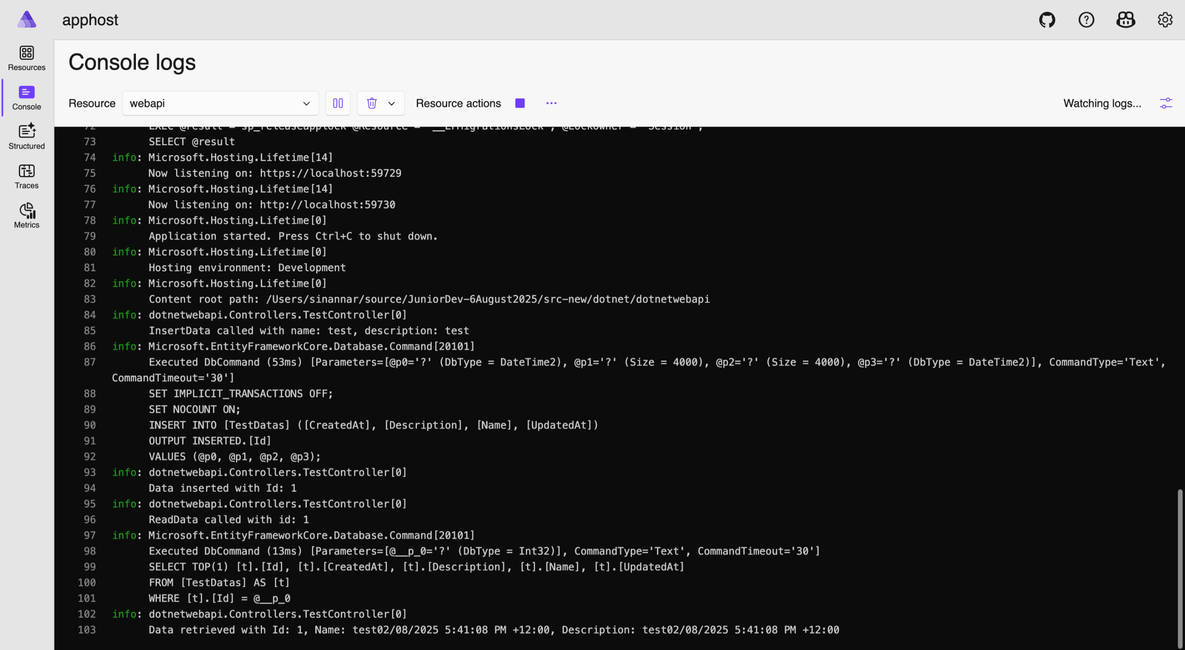
aspire dashboard (cont.)

Slide 22
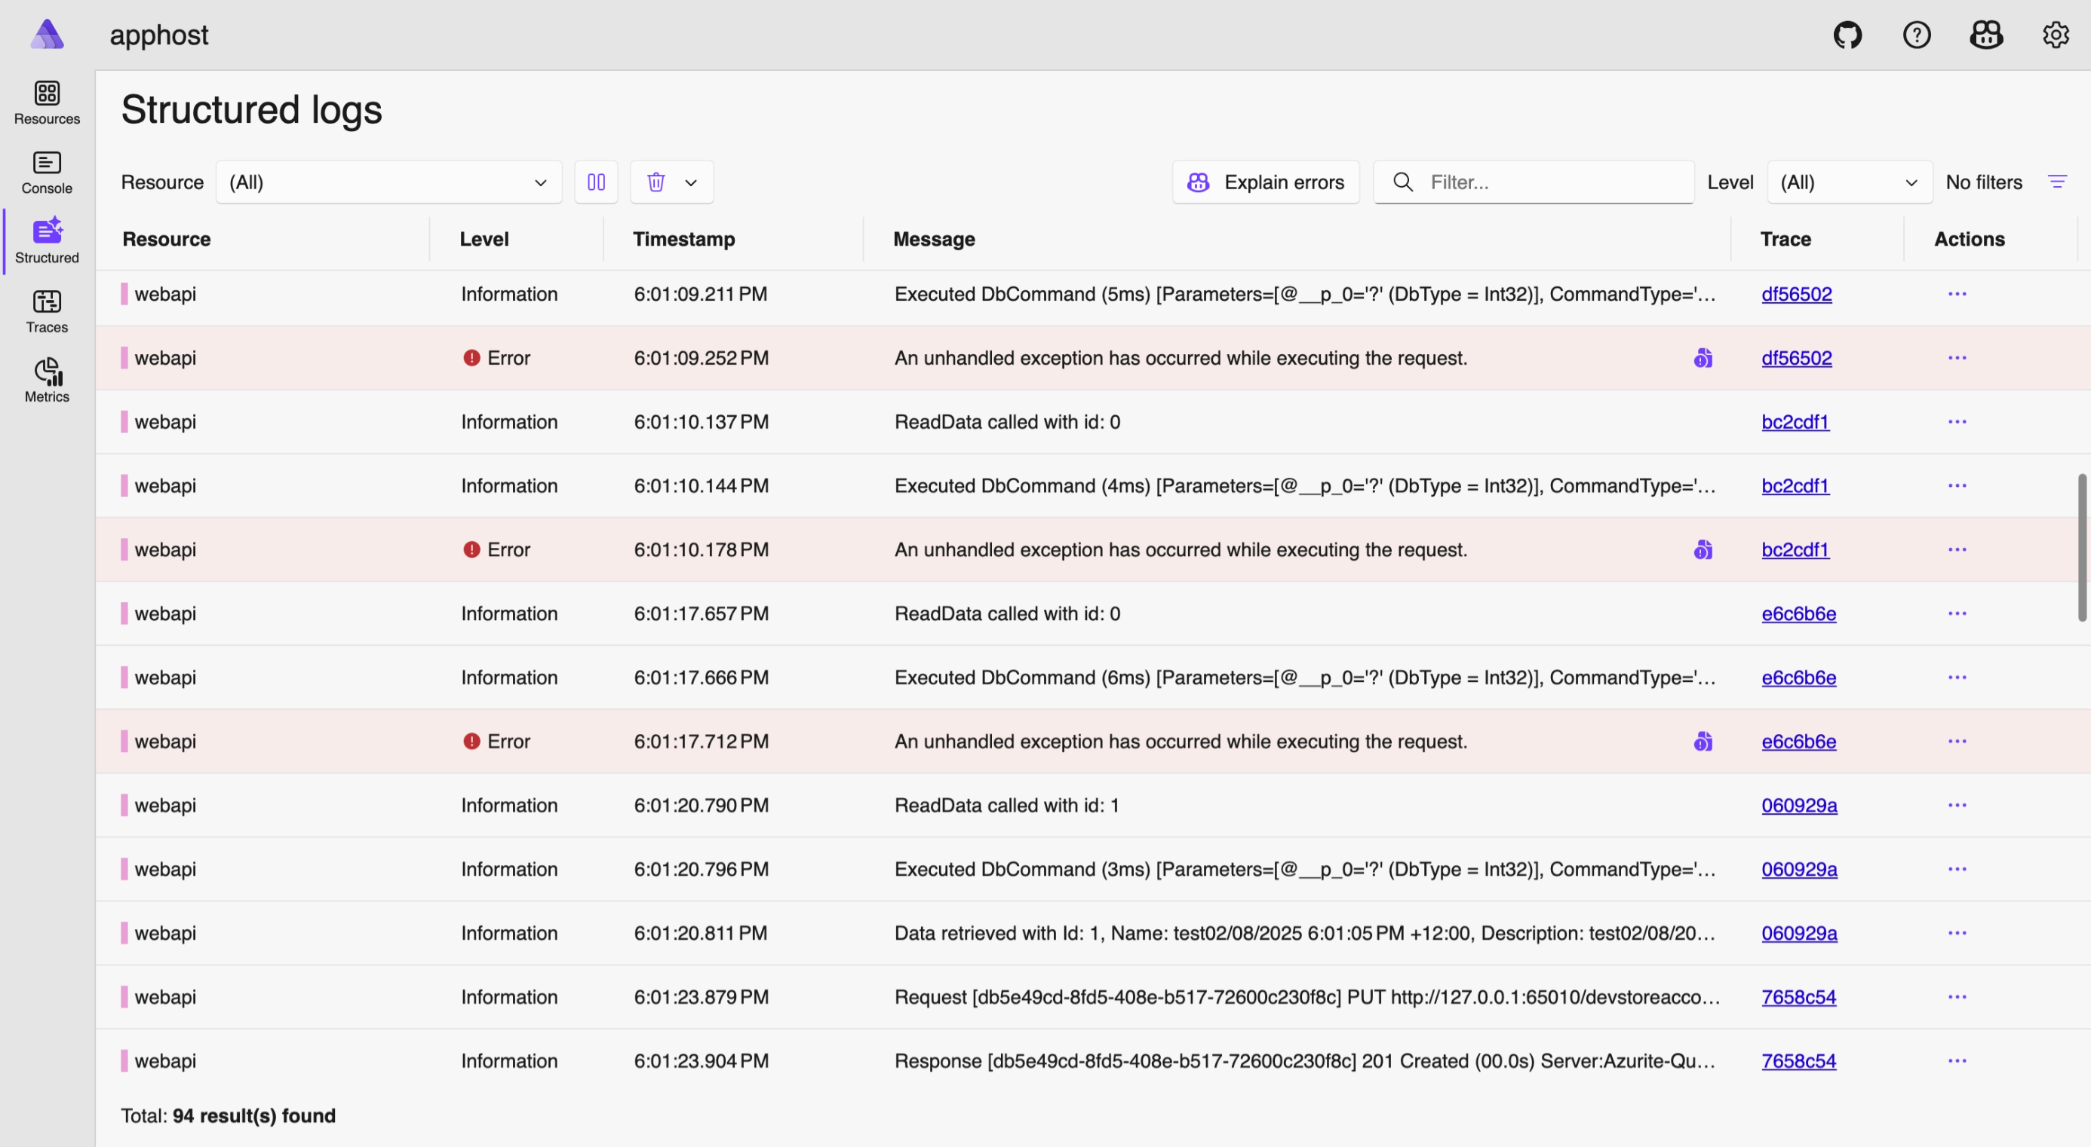
aspire dashboard (cont.)

Slide 23
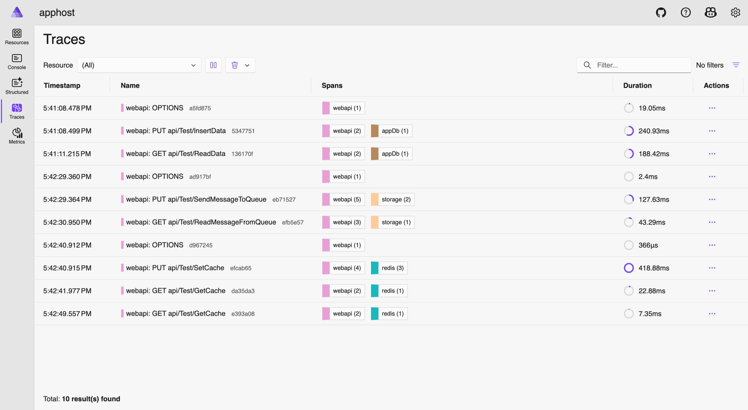
aspire dashboard (cont.)

Slide 24
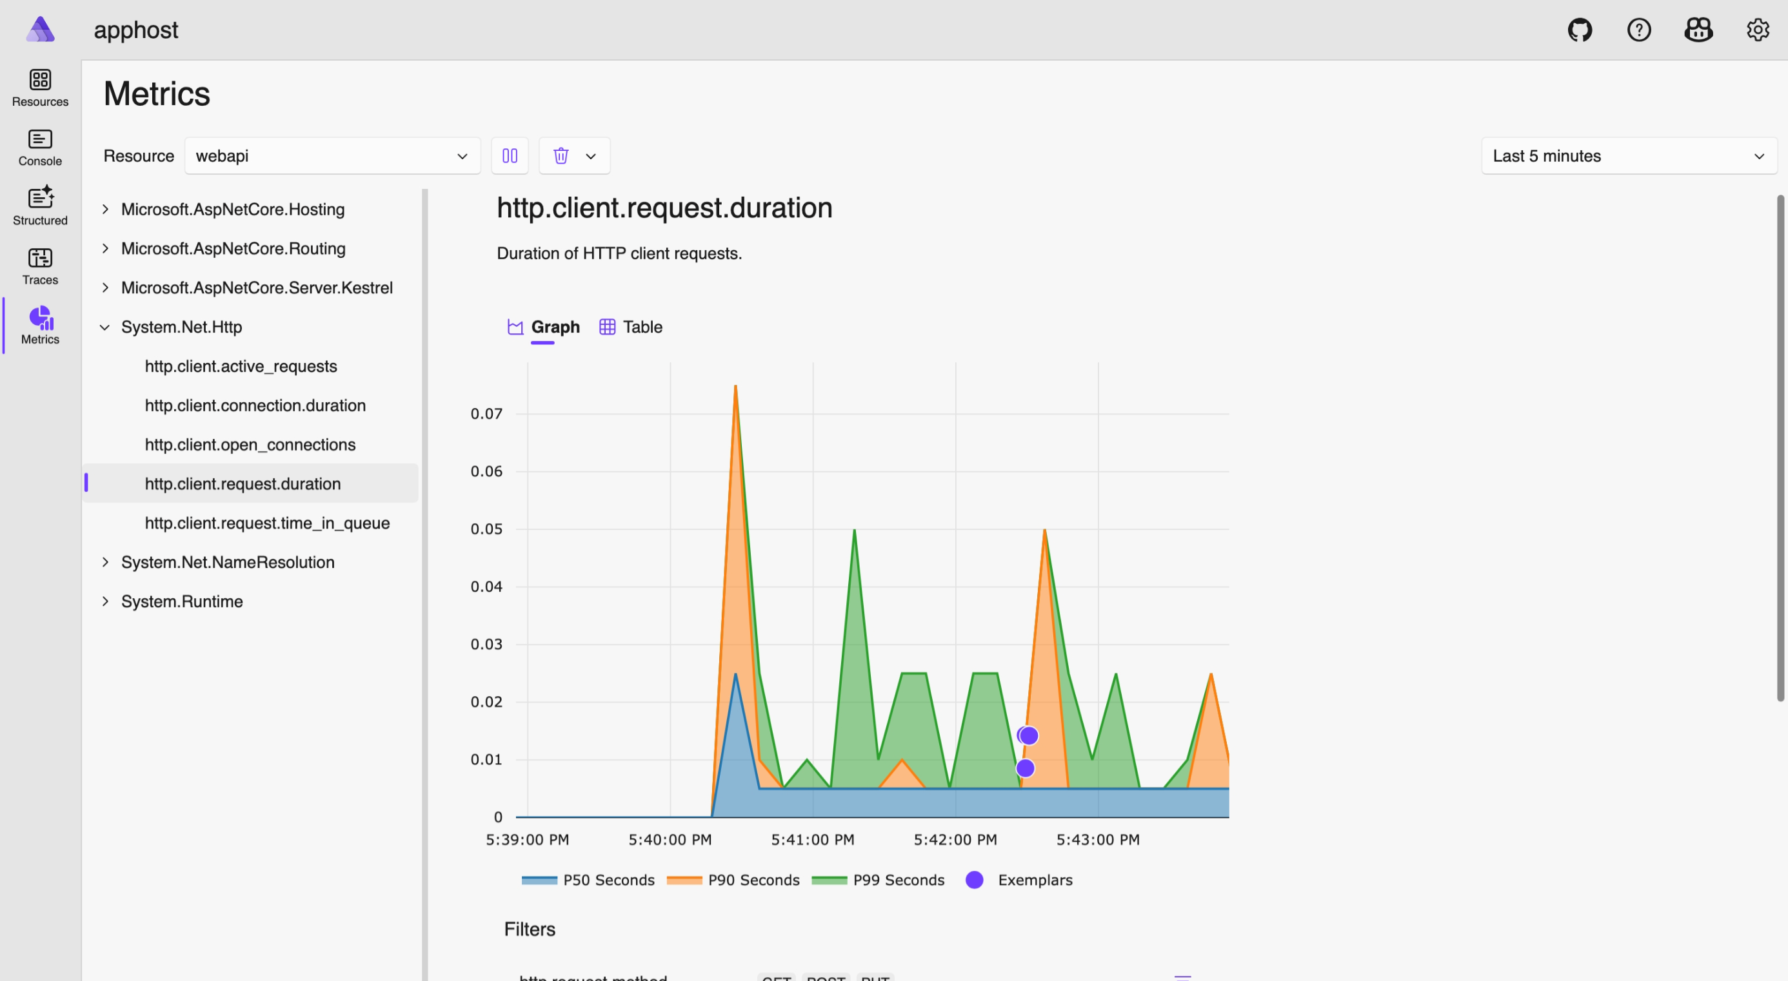
aspire dashboard (cont.)

Slide 25
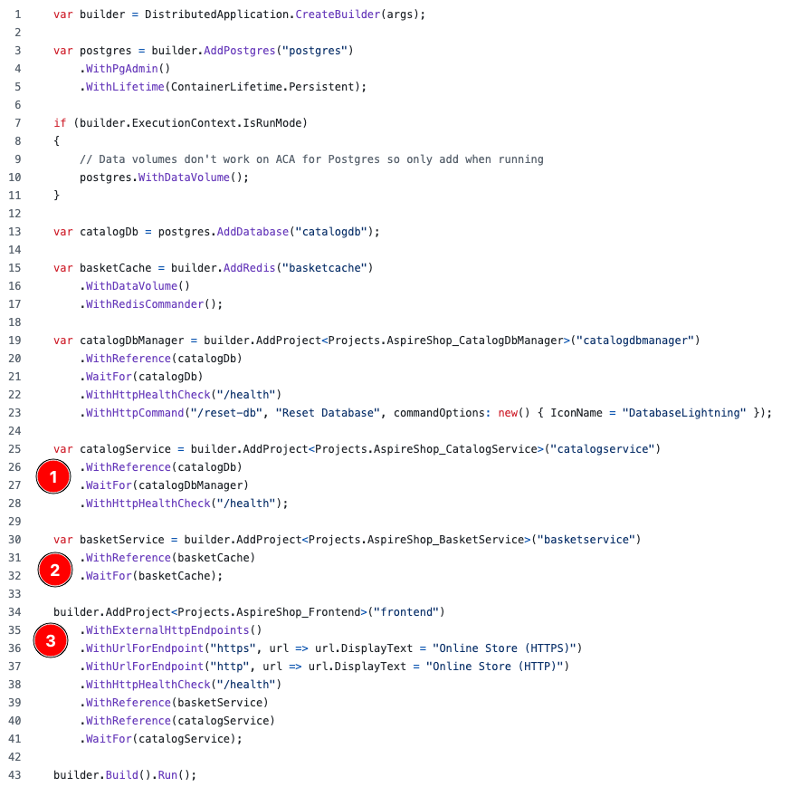
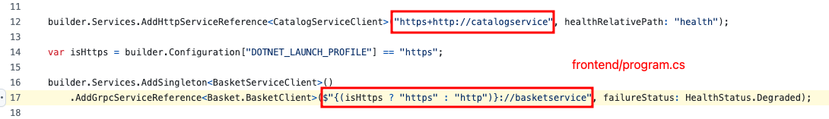
1
2
3
4

Slide 26
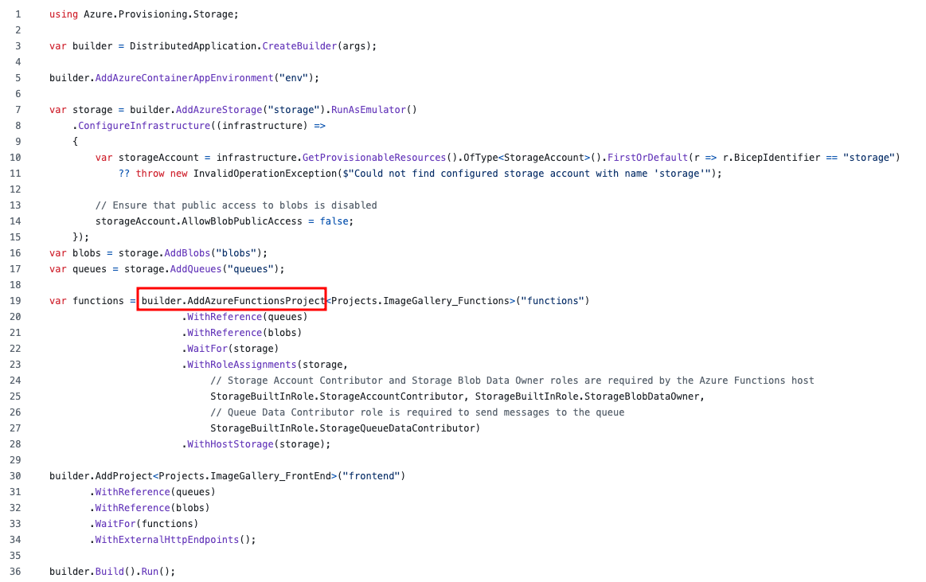
examples

Slide 27
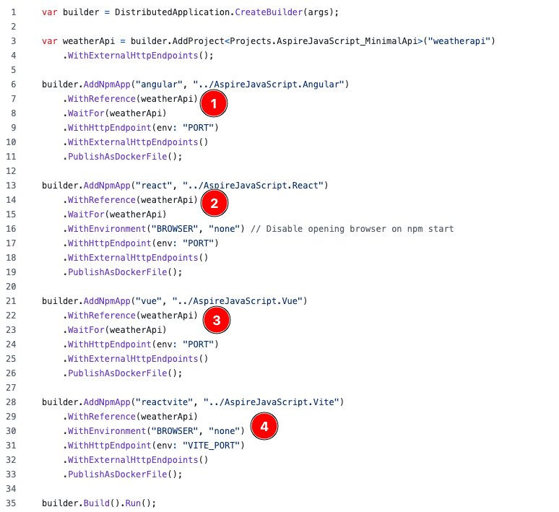
examples

Slide 28
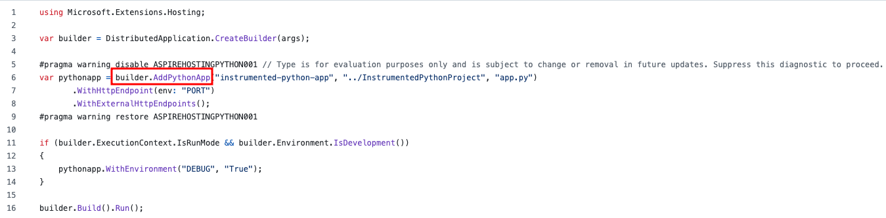
examples

Slide 29
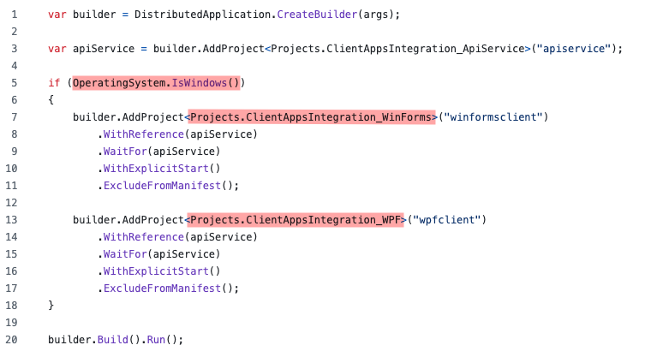
examples

Slide 30
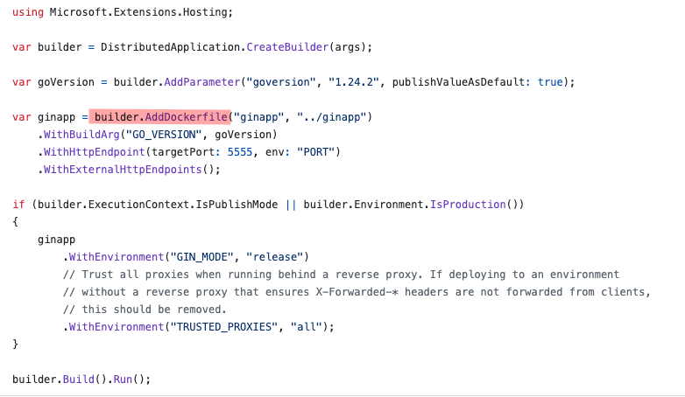
examples

Slide 31
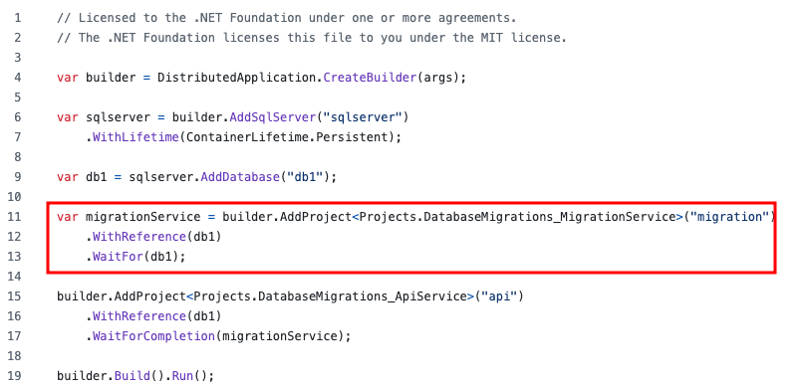
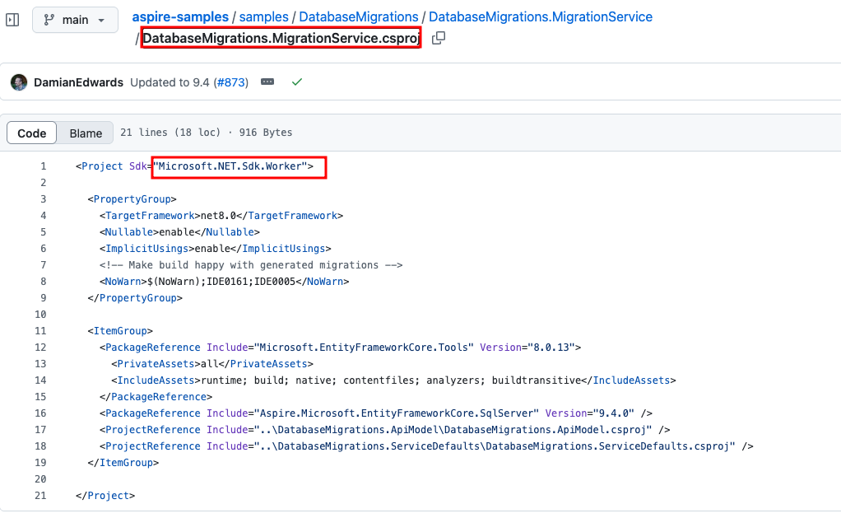
examples

Slide 32
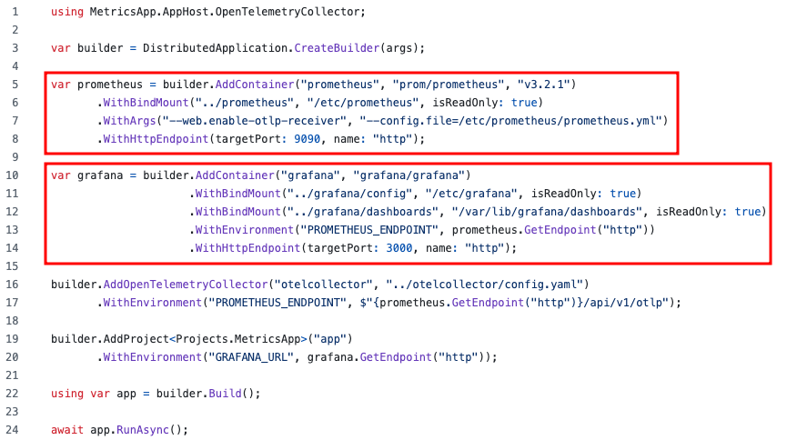
examples

Slide 33
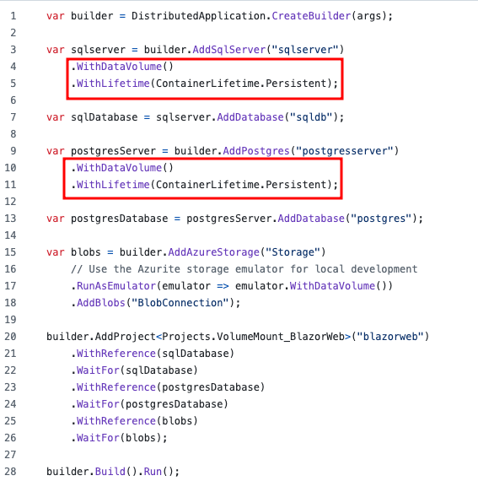
examples

Slide 34
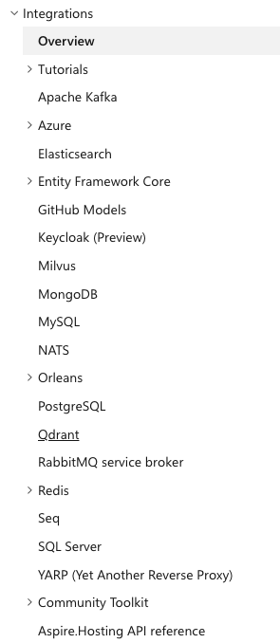
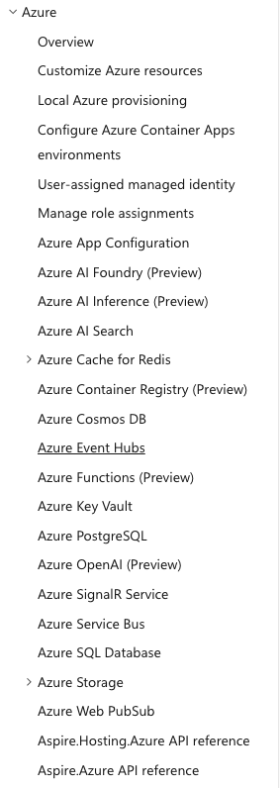
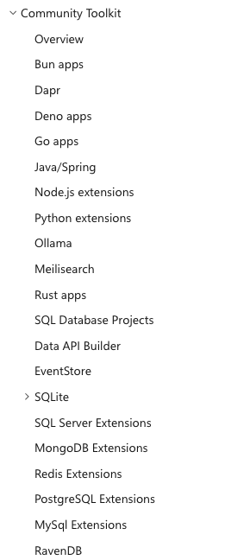
aspire integrations

Slide 35
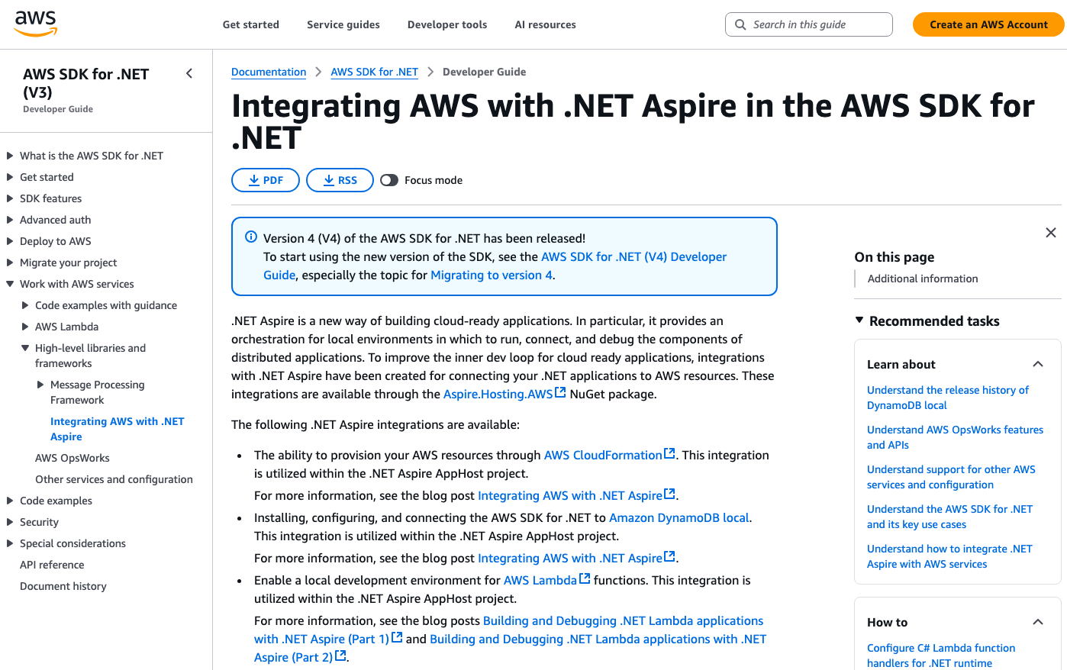
aspire integrations(cont)

Slide 36
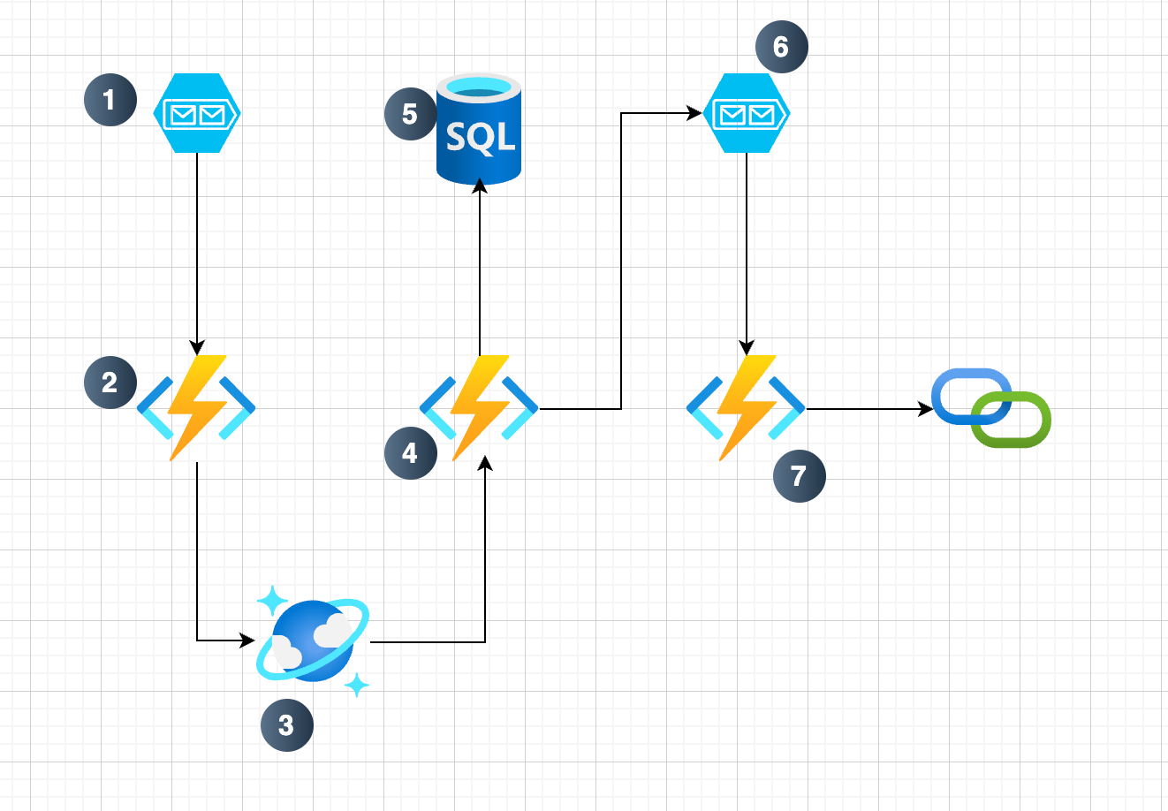

intro to .net aspire blog post

Slide 37

thank you for listening
github.com/dotnet/aspire
github.com/dotnet/aspire-samples/tree/main/samples
AspireShop/AspireShop.AppHost/AppHost.cs
AspireWithAzureFunctions/ImageGallery.AppHost/AppHost.cs
AspireWithJavaScript/AspireJavaScript.AppHost/AppHost.cs
AspireWithPython/AspireWithPython.AppHost/AppHost.cs
ClientAppsIntegration/ClientAppsIntegration.AppHost/AppHost.cs
ContainerBuild/ContainerBuild.AppHost/AppHost.cs
DatabaseMigrations/DatabaseMigrations.AppHost/AppHost.cs
learn.microsoft.com/en-us/dotnet/aspire/
github.com/sinannar/JuniorDev-6August2025

